Slide 1
Layout course-
Mechanical considerations
Oren S.

Slide 2
Agenda
Electronic designer preparations
Mechanical designer tasks/ documents
Mechanical design considerations and constrains
Thermal considerations
Production considerations and constrains

Slide 3
Mec Design for layout
The Mec. PCB considerations are defined by:
Product type and requirement- Power/ Logic/ RF, low/ high voltage, accessible or embedded, etc.
External Interfaces- Connectors, Display, RF, daughter boards, etc.
Enclosure type and restrictions-
  Plastic/ Sheet Metal/ Die Cast
  Type of heat sink: extruded, die cast, or other, passive or forced air.
  Dimensions: width-Height-Length-Weight-Look-Accessibility
Manufacturing and assembly sequence and process-
  what sits on top other, etc.
  Manufacturing Quantity (P/T, / Samples/ Mass Production)
Standards and Regulations
Cost target

Slide 4
Mec Engineer preparations for layout
The Mec. Engineer will build a 3D model based on the above.
This model will be the base design for the PCB.
From the 3D Model, The Mec engineer will produce a DXF file with instructions to the Layout Editor.
The Layout Editor will embed this DXF file in the PCB Layout CAD

Slide 5
DXF
Bear in mind, that the first DXF is the base design guideline;
It can be changed during the layout process.
You must know the restriction and flexible points
DXF file includes:
Boundaries/ Outlines
Restricted areas
Mec holes
Height map
Connectors
Clearance Creepage to enclosure
Large/ Tall components Position
Stiffener (if needed)

Slide 6
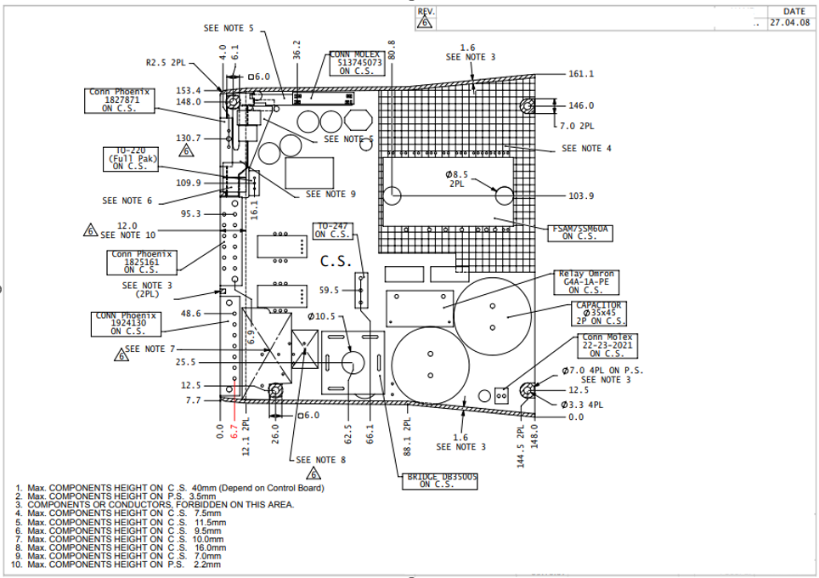
DXF Example
Mec. Holes
Connectors
Large/ Tall components
Height Restrictions
Clearance

Slide 7
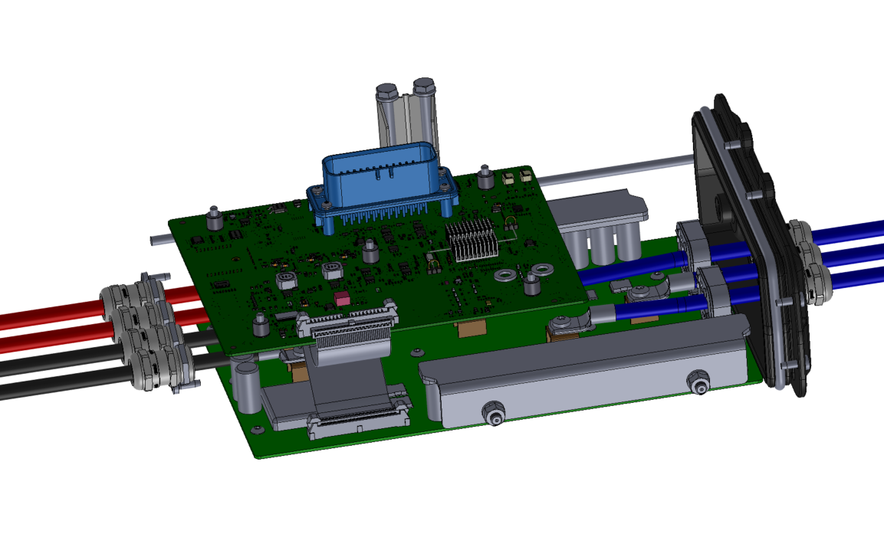
3D- eDrawings
Example: GoKart
External connector
Cables routing
Aluminum Caps holder
Board to board connection
Power FETs

Slide 8
PCB Thickness
Standard thicknesses:
  multiplications of 0.8mm (0.8, 1.6, 2.4, 3.2mm)
  multiplications of 1.0mm (1.0, 2.0, 3.0mm)
Considerations-
  PCB stiffness/ Flexibility (large size, heavy components, production mobility)
  User / mec. Support- connectors assembly, vibrations
  Thermal
For thick PCBs (>2mm), need to check TH components compatibility;
TH pin should be 1.0-3mm out of the PS surface
Thick PCB has unique FP for TH components
PCB Thickness should be part of the mec. model

Slide 9
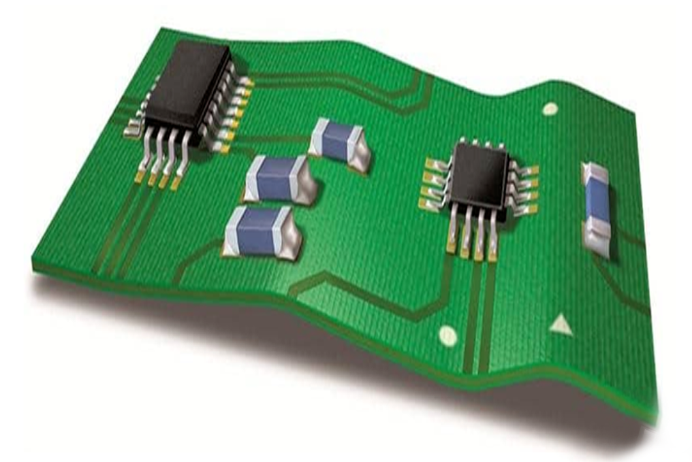
PCB Warpage
The IPC defines max allowed PCB warpage.
This Warpage is caused due to mec. Tolerances and PCB production deformation
  According to IPC standards, the permissible warpage
  for a PCB board with surface mount components is 0.75%,
  whereas for a PCB board without surface mount components,
  it is 1.5%.
  For high-precision and high-speed placement,
  some electronic assembly manufacturers
  have stricter requirements for warpage.
  Some requirements allow for 0.5% warpage,
  and a few, such as BGA, requires 0.3%
Assembly Warpage is defined by the
height tolerance and the distance
between opposite anchor points.

Slide 10

PCB Deformation
Deformation calc. Example:
Anchor
point 1
Anchor point distance
PCB Warpage
Anchor
point 2
Tolerance
Spacer
Power IC
Accumulated Tolerance
Σ{Mec + Chip + TIM + …}
TIM
Warpage [%] = (Tolerance) / (Anchor point distance) *100%
Example:
Accumulated Mec. Tolerance 500µm
Max Warpage 0.75%
Min Distance: $\frac{0.5mm}{0.0075}$=$66.6mm$
Distance between anchoring points should consider
PCB flexibility (leads to larger distance)
Vibrations (leads to shorter distance)

Slide 11
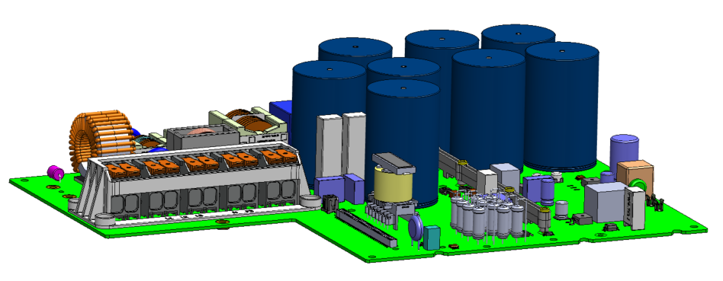
Components height
Tall components, such as Aluminum Elect. Capacitors, should have a special consideration.
  Collision with other components or mec. Parts
  Consider stress on PCB and part- pins due to vibrations
  In case of tall SMD parts, consider via holes
  to enforce the bonding

Slide 12
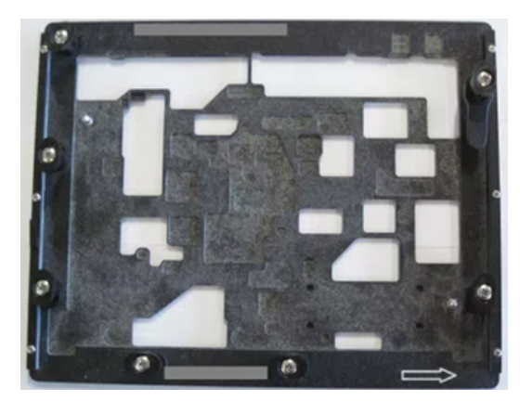
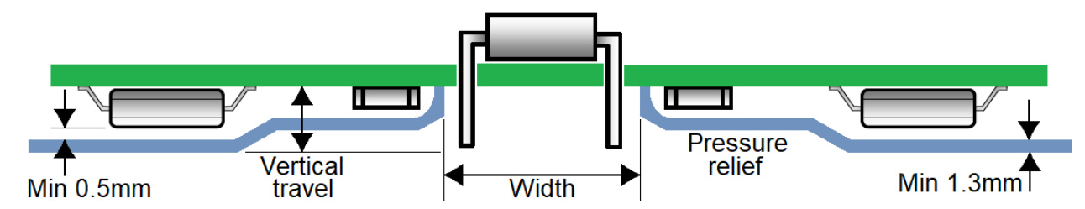
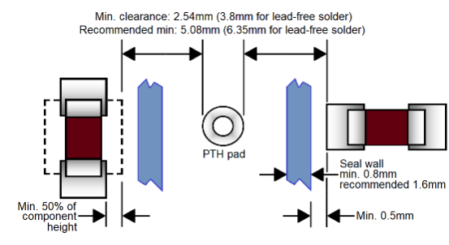
Production Methode- TH/ SMD
TH parts can be soldered by few technics (Wave/ Robotic/ Laser).
Most common practice is Wave Solder with a selective Pallet.
Side view (section) of a selective Pallet
Distance between TH pads and
SMD pads on PS is according to
the SMD parts height.
Max height of SMD part on
PS (for wave soldering) is 7mm
selective Pallet

Slide 13
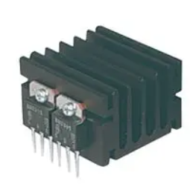
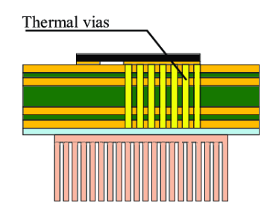
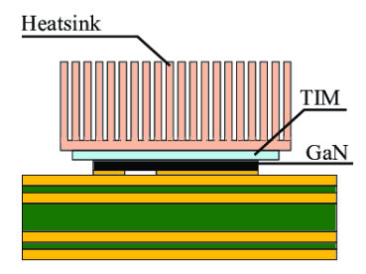
Thermal considerations
Hi Power components requires cooling,
As per the ambient conditions, and the power to be dissipate, a thermal consideration should be study.
Power parts can be cooled to Heat Sinks as:
  TH connection to heat sink(TO-220/ TO 247)
  Bottom side cooled
  Top Side cooled
FET
PCB
TIM
PCB
FET
TIM
Heatsink

Slide 14
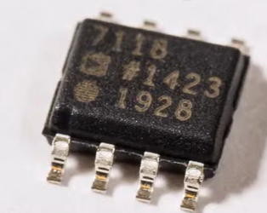
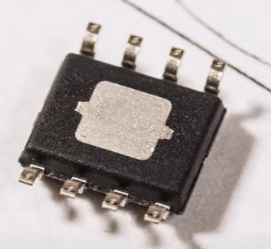
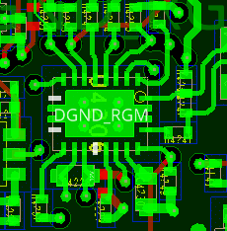
Thermal considerations
Copper thickness is defined in copper weight in units of ounces (oz.)/ square foot area
  Hi current traces- need to use PCB trace calculator.
  Considerations are temp rise and power losses.
  note the difference between internal and external layers.
  https://www.advancedpcb.com/en-us/tools/trace-width-calculator/
  Standard copper thicknesses:
    0.5oz. (17µ)
    1oz. (35µ)
    2oz. (70µ)
  Thicker layers are available too, but not std.
  Internal layers cooling using Vias
Bottom side cooling components
When having large components, consider path for
air flow/ ventilation between them.
Try to spread the power sources to avoid hot spots.
Bottom Side Cooling

Slide 15
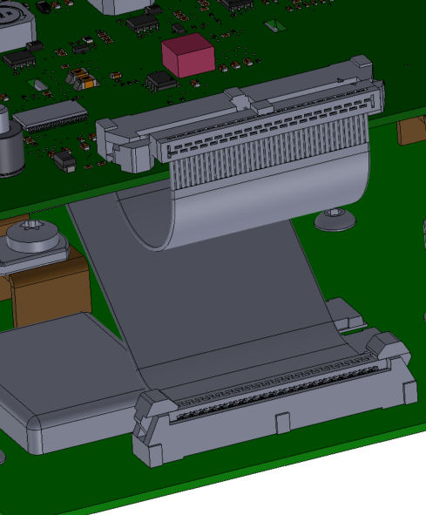
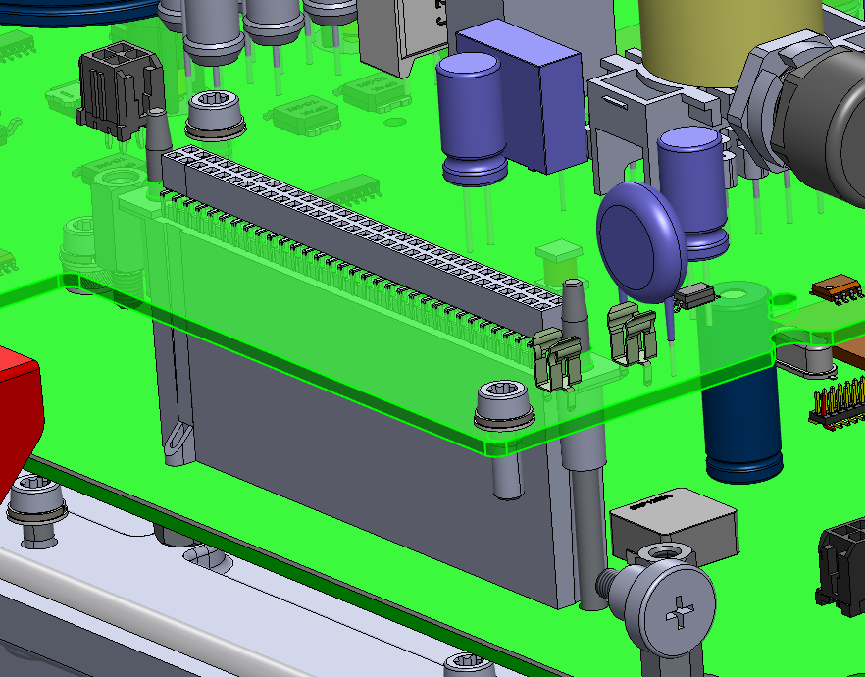
Connectors
Flat Cable (IDC) B2B connection (GoKart)
pin#1 (!!!!)
Mating connectors
  Vertical/R/A
  Mirror
  Pin # 1 (IDC/ BE/ TE)
pin#1
Bottom Entry, pin#1
BE B2B connection (V4)
* If mating connector is placed on PS, it is mirrored. Need to make sure that the schematics are according with the physical pins

Slide 16
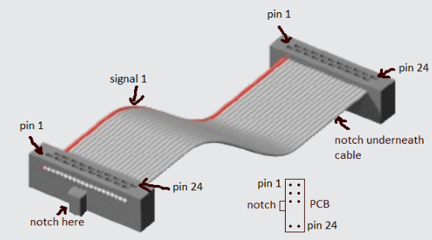
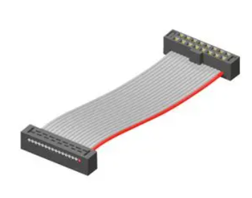
Connectors- cont.
Connectors on same side
Connectors on opposite side
Side B
Side B
Side A
Side A
Side B
Side A
Pin 1
Side A
Side B
Pin 1

Slide 17
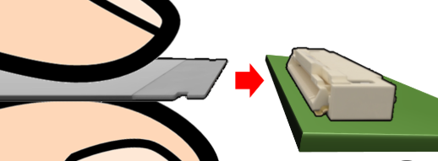
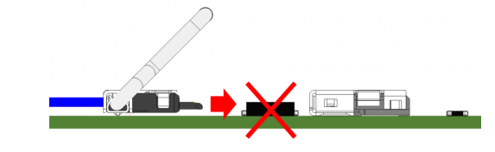
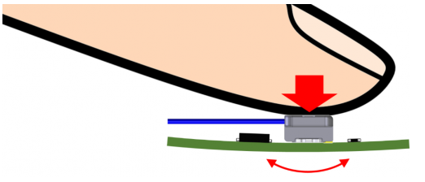
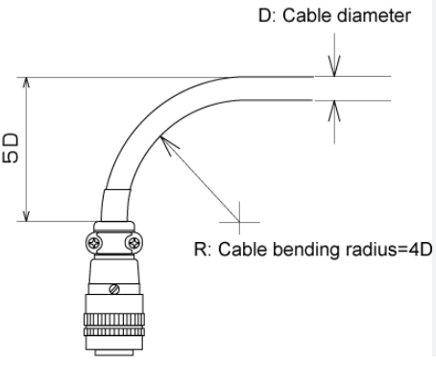
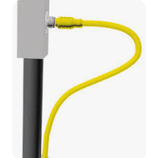
Connectors- cont.
Mating connectors:
  Accessibility
    Consider Cable routing and fingers accessibility
  Support PCB other side from bending
    while placing the mating connector
  Consider Cable bending radius

Slide 18
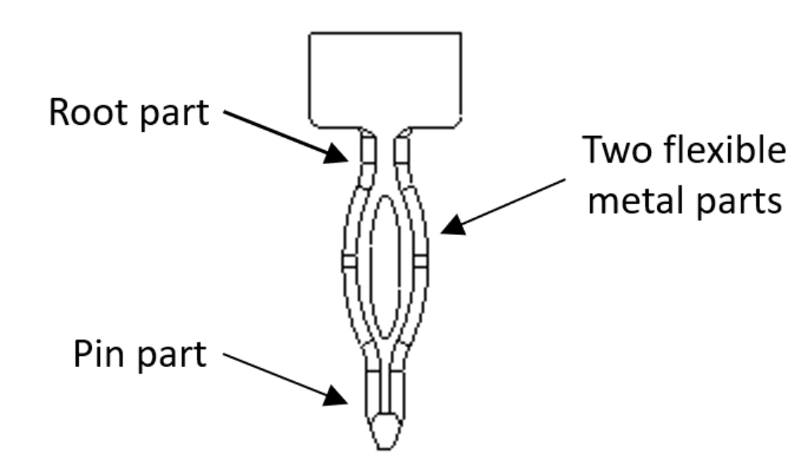
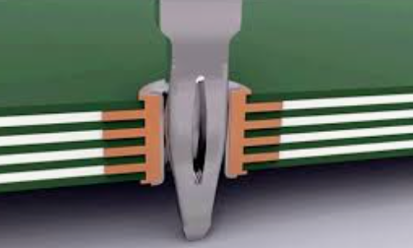
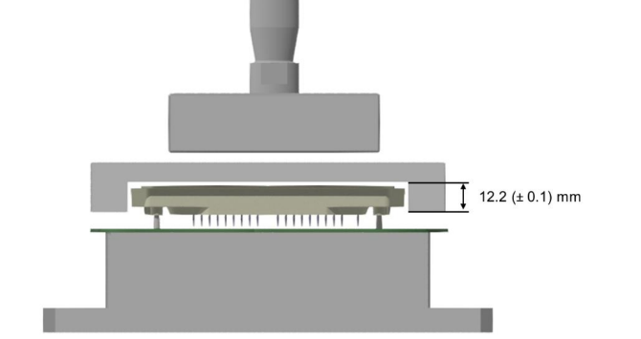
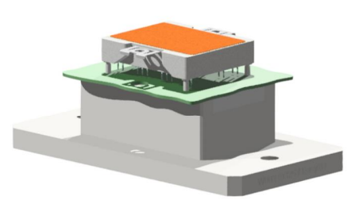
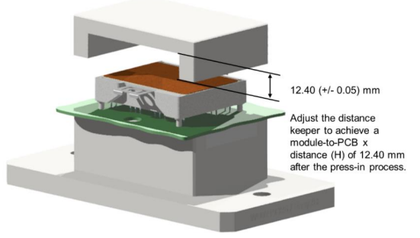
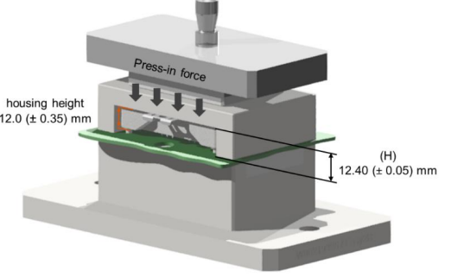
Press-Fit components
Press Fit technology is used to replace TH soldering
The main advantage is the option to assemble high power components on the top of the PCB
Special care should be taken on:
  Hole size, plating and tolerances
  Distance between the hole and SMD
  Comp. due to stress on PCB during assembly
  Clear PCB area on the opposite side for support tool
  A press fit tool should be design for manufacturing;
  if need P/T w/o the tool, need to define special holes size

Slide 19
Stiffeners and handling
Large PCBs with heavy components may bent during the manufacturing process.
PCB bending may brake SMD components
The vulnerability depends on:
  PCB Size
  Components weight
  PCB thickness
If the PCB needs stiffener, this part must be considered before placement stage is completed.
Also, a consideration should be taken on the PCB handling during manufacturing
Large capacitors are NOT PCB handling tool
PCB Stiffener

Slide 20
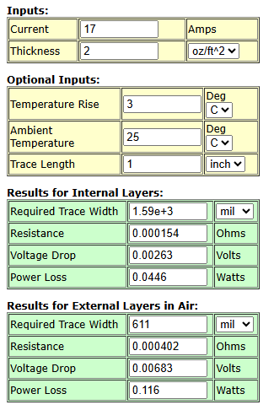
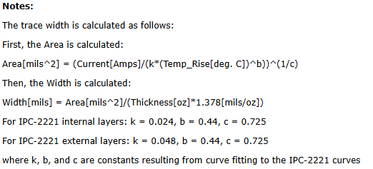
Trace width calculation
https://circuitcalculator.com/4pcb/trace_width_4pcb.htm

Slide 21
Design Process
  Create a PCB number:
    D1234A (for a new PCB)
    D1234AB (for layout change).
  Coordinate with the mechanical dept. manager which designer will work on the project;
  Inform the mechanical manager and the mechanical designer about the expected date of the layout start.
    Open a ticket in Jira for the thermal design of the PCB.
  PCB information:
    The PCB purpose.
    The requested PCB size / area.
    PCB thickness.
    Electrical flow (Power area , digital area…..).
    Required interfaces with the product / other PCB.
    Expected hi power components required cooling.
    EMI expected issues.
    New or special components.

